Slide 1

GreenVolt
Tagline or something idk.

Slide 2
What is GreenVolt?
GreenVolt is an online platform dedicated to promoting renewable energy adoption and fostering connections within the green energy community. It offers a variety of features to educate, facilitate, and empower individuals and organizations in their transition to renewable energy sources.

Slide 3
Mission and Vision
Our mission and vision is to create an environment where everyone can learn more about green energy alternatives and buy these alternatives and one day completely remove all the carbon footprints from the world.

Slide 4
Market Opportunity
GreenVolt is the one of the only source out there which provides educational content as well as the extensive marketplace for buyers and sellers.

Slide 5
Business Model
GreenVolt earns money from ads, sponsorships, user donations, Marketplace Transactions, blog monetization and much more!

Slide 6

Technical Details
Language used for back-end: Python
Back-end Libraries: FastAPI, Jinja2, Markdown, motor, pymongo, uvicorn, dnspython.
DataBase: MongoDB.
Front-end: HTML, CSS, JavaScript.
Front-end Frameworks: TailwindCSS, typography.

Slide 7
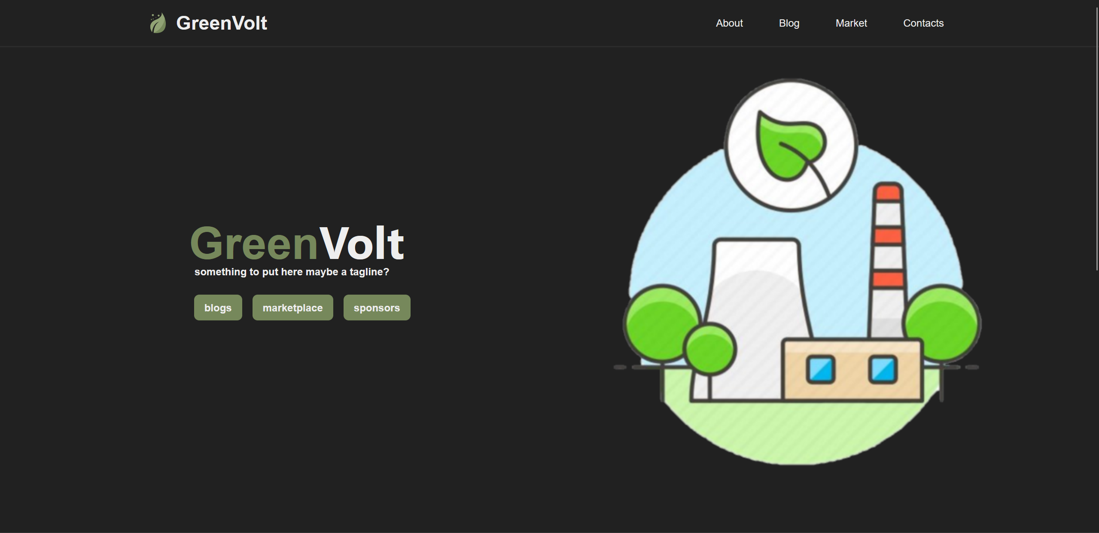
Prototype
GreenVolt as a simple yet so elegant design.

Slide 8
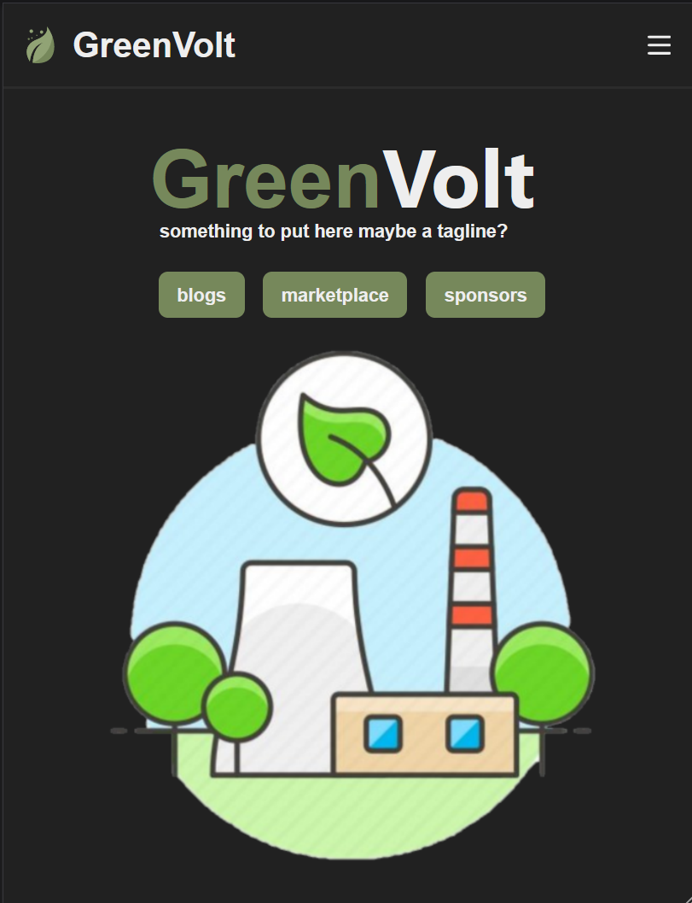
Prototype
User experience comes first and mobile responsiveness is a must.
GreenVolt is a website where every single page is optimized of all Morden phones and tablets.

Slide 9
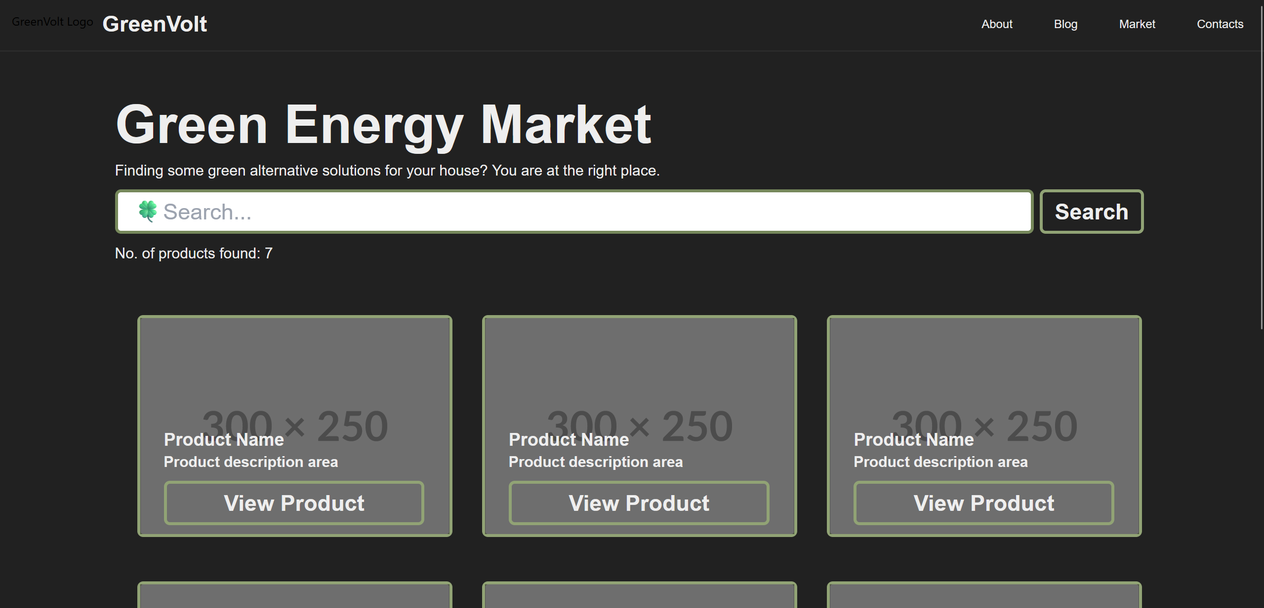
Prototype
Marketplace GreenVolt ‘s heart and soul.

Slide 10
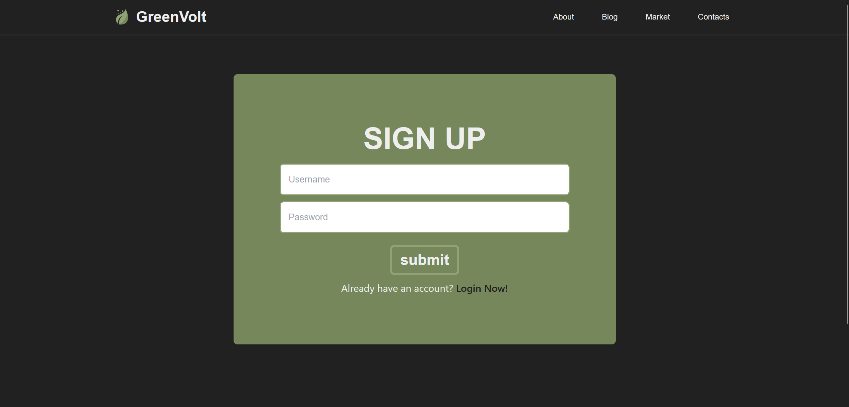
Prototype
Sign up and join us now!

Slide 11
Team
Sometimes working leads to the greatest inventions.
NAME: Krish Sharma
Institute: Manipal University Jaipur
Registration Number: 23FE10CAI00138
Phone No: +91 8287735005
Mail: krishsharma0413@gmail.com

Slide 12
Thank You

